Slide 1
Data Structure
class DataLine
{
private:
Descriptor History; ///< History of all the commands run on the file
Units::Base* UnitType; ///< Unit type
std::vector<double> Xvec; ///< Xvalues :
std::vector<double> Yvec; ///< Yvalues
std::vector<double> Evec; ///< Error values
class DataMap
{
private:
typedef boost::multi_array<double,2> mapArray;
Descriptor History; ///< History of all the commands run on the file
mapArray* Ydata; ///< The Y array
mapArray* Edata; ///< The Error Array

Slide 2
Data Structure
class Spectra
{
private:
typedef RefControl<std::vector<double> > vecType;
int Index; ///< Index coordinate
double L1; ///< L1 distance (note that this is different for each sample (possibily)
Geometry::Vec3D Position; ///< Position in space relative to sample
double Qangle; ///< Angle in radians from sample
double Qconvert; ///< Number to divide by time bin to get Q [angstrom^{-1}]
double Wconvert; ///< Number to multiply by time bin to get wavelength [angstrom]
int nTime; ///< Number of time bins
int nData; ///< Number of data bins (Ntime-1)
RefControl<std::vector<double> > TBin; ///< Time bins (reference count this)
RefControl<std::vector<double> > Y; ///< Y values
RefControl<std::vector<double> > Err; ///< Error terms

Slide 3
Data Structure
class WorkSpace
{
private:
Descriptor History; ///< History of all the commands run on the file
protected:
std::vector<Spectra> Monitors; ///< List of monitors
std::vector<Spectra> Pixels; ///< List of all the pixels
-arithmetic operations on workspaces….

Slide 4
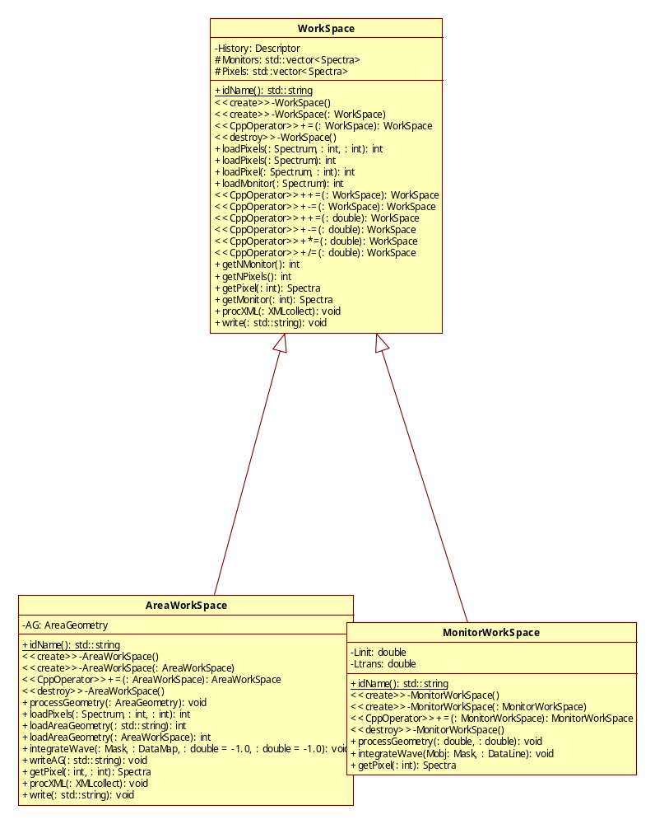
Data Structure

Slide 5
Central Data Store
Singleton class MasterDirect. (Central Data Store)
MaskGrp::Mask MComp; ///< Mask component
RawFile::Spectrum SpecObj; ///< Data read Object
std::vector<TimeData::WorkSpace*> WorkGrps; ///< Raw Spectra
std::vector<DataMap*> Areas; ///< Area Maps
std::vector<DataLine*> Lines; ///< Single lines
Methods to get and set Objects from the store.

Slide 6
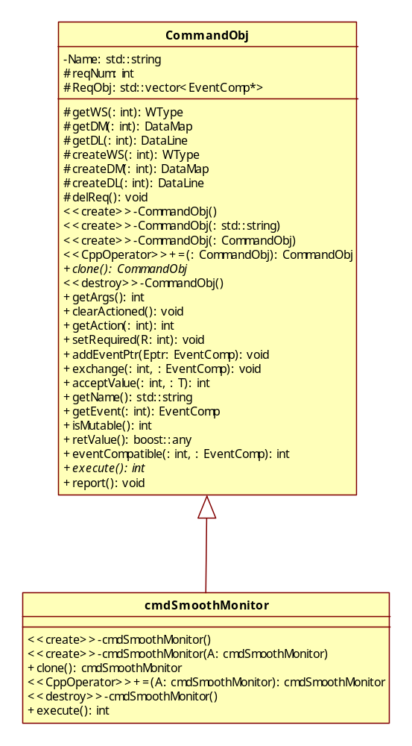
Commands
A central Command Factory
(Command maker used to register concrete commands in the factory)
CommandObj is the interface for all command objects
class CommandObj
{
private:
std::string Name; ///< Command Name
protected:
int reqNum; ///< Minimum required
std::vector<EventComp*> ReqObj; ///< The request object
public:
virtual EventComp* getEvent(const int); // Allows poly-object events
virtual int isMutable() const { return 0; } ///< is the function able to add events
virtual boost::any retValue() const;
virtual int eventCompatible(const int,const EventComp*) const;
virtual int execute() = 0;
virtual void report() const;
};

Slide 7
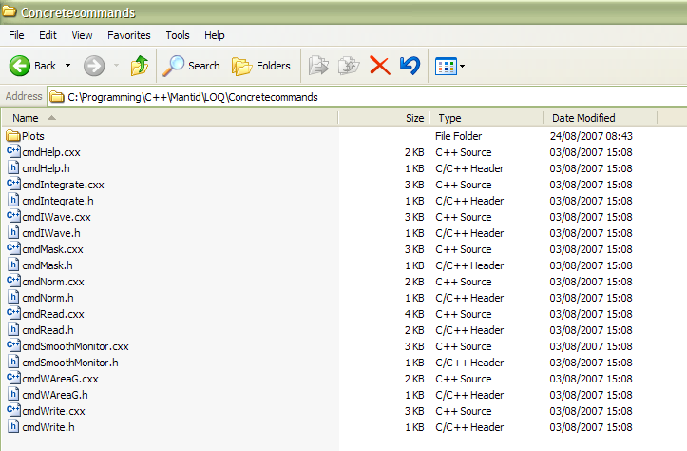
Concrete commands

Slide 8
“Geometry”
class InstrumentInfo
{
private:
static double lPrimary; ///< Moderator to sample distance [metres]
std::string instName; ///< Instrument name
std::vector<int> Monitor; ///< Vector of Monitor indexes
std::vector<Det> Detector; ///< Vector of Detector position information
class AreaGeometry
{
private:
int xPixels; ///< Number of x-pixels
int yPixels; ///< Number of y-pixels
Geometry::Vec3D Centre; ///< Centre position [metres]
Geometry::Vec3D Corners[4]; ///< Corner positions [meters]
Geometry::Vec3D PixelX; ///< unit vector in X direction [metres]
Geometry::Vec3D PixelY; ///< unit vector in Y direction [metres]

Slide 9
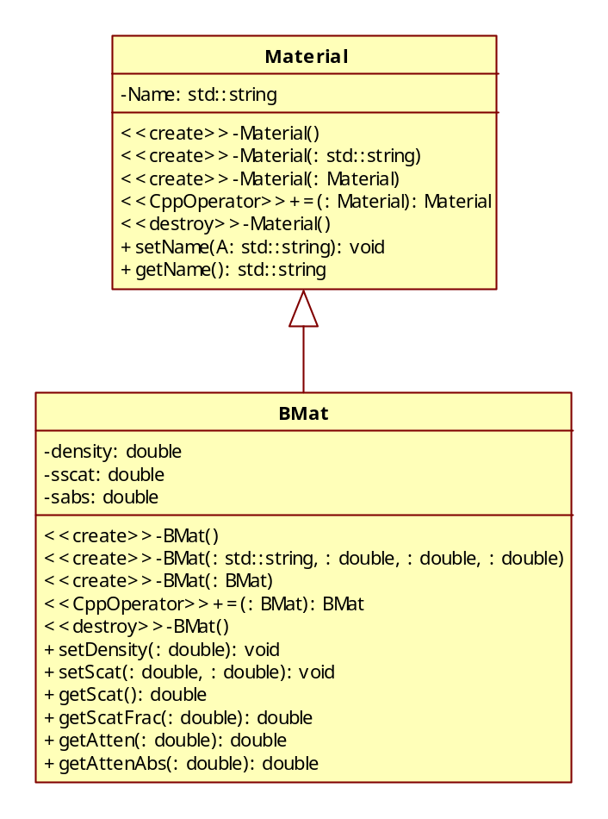
Materials

